Slide 1
VETERANS Express Lanes
July – 19, 2017

Slide 2
Approach
Section - 1

Slide 3
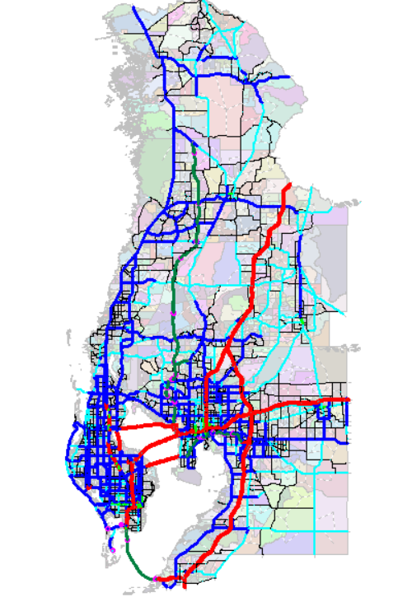
Tampa Bay Regional Planning Model
Approach
Model Years:
2010: Base Year
2019: EC (Existing + Committed)
2030: ICA
2040: CA (Cost Affordable)
Veterans Express Way

Slide 4
Networks and Assignment Parameters
Approach
Networks
Veterans Expressway for 2020 and 2040 are extracted out from TBRPM
Starting point for future year projects
To be consistent with the regional assignment model procedures
Number of lanes are consistent with the Toll Plan
Assignment Settings
TBRPM | Initial | Iterative
Speeds | 60 MPH | CGSTSPEED = LI.DISTANCE / (LI.TIME / 60)
Capacity | 2070 | LI.CAPACITY * LI.NUM_LANES * LI.UROADFACTOR / LI.CONFACAMP
ODME Enhancement: For Daily ODME application, Capacities are set to 10 hour capacity (CAPACITY * LANES * 10)

Slide 5
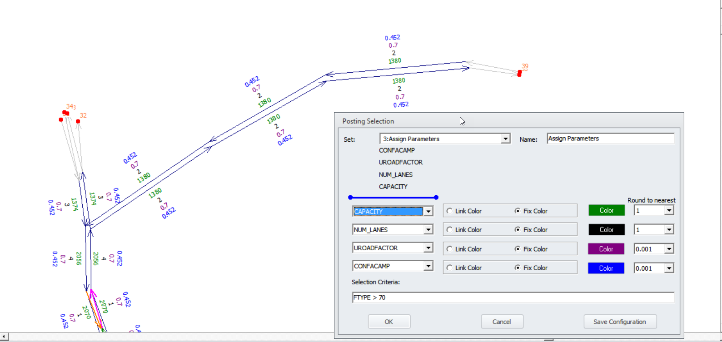
TBRPM – Assignment Settings
Approach
Speeds are coded at 60 MPH
Capacities along Veterans Expressway are set @ 1380 – 2070 vehicles / hour / lane

Slide 6
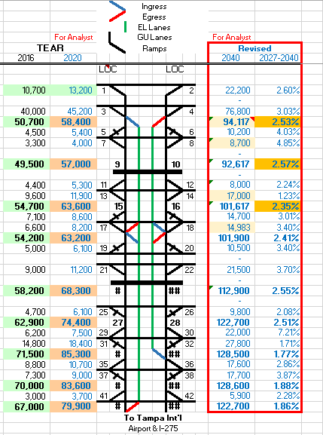
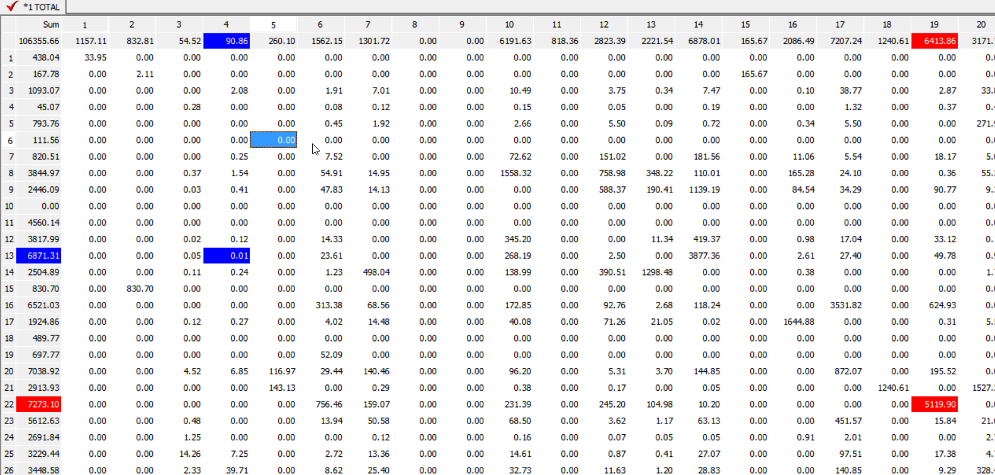
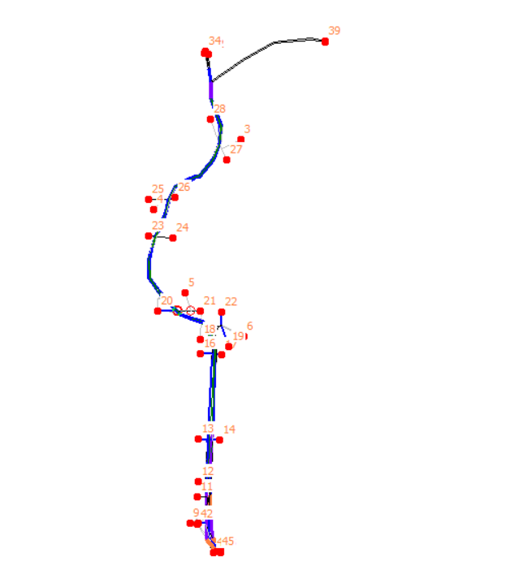
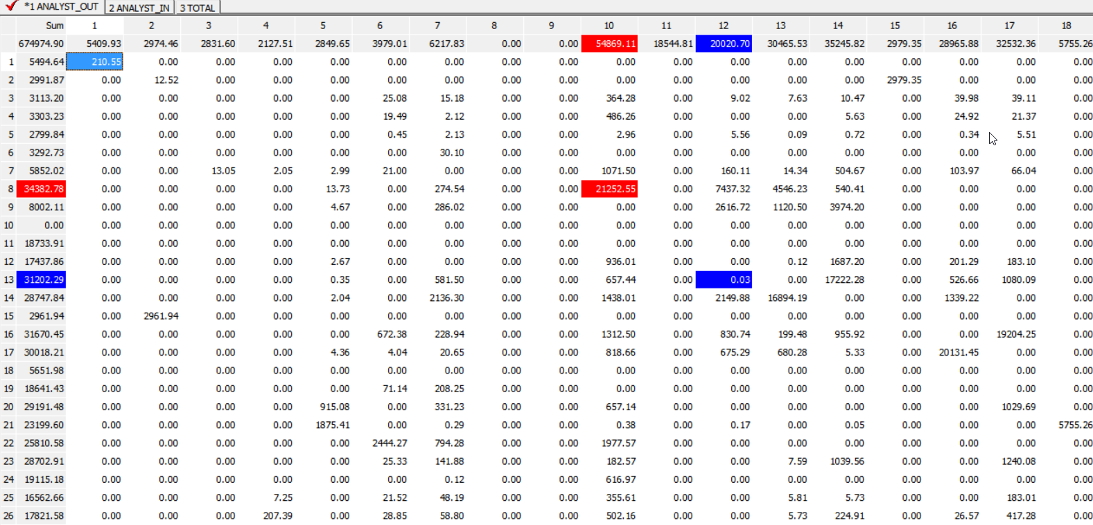
Approach
ODME Development
Initial Subarea OD Tables from TBRPM
Profile: AADTs from 2020 TEAR and 2040 TRENDS
Develop ODME procedure with TBRPM assignment and extracted subarea networks, subarea OD seed matrix and profile as control totals
Profile: TEAR & TREND
TBRPM: 2019 & 2040
Subarea OD Tables:
AM, MD, PM, EV
ODME : Daily Table
Subarea Network
Subarea OD Tables: Daily

Slide 7
Approach
ELTod Application
Describe how eltod is applied (toll links specification, pull links, network speeds, network edits if any, comparison of the extents of the model )
Profile: TEAR & TREND
TBRPM: 2019 & 2040
Subarea OD Tables:
AM, MD, PM, EV
ODME : Daily Table
Subarea Network
Subarea OD Tables: Daily

Slide 8
ODME - Validation
Section - 2

Slide 9
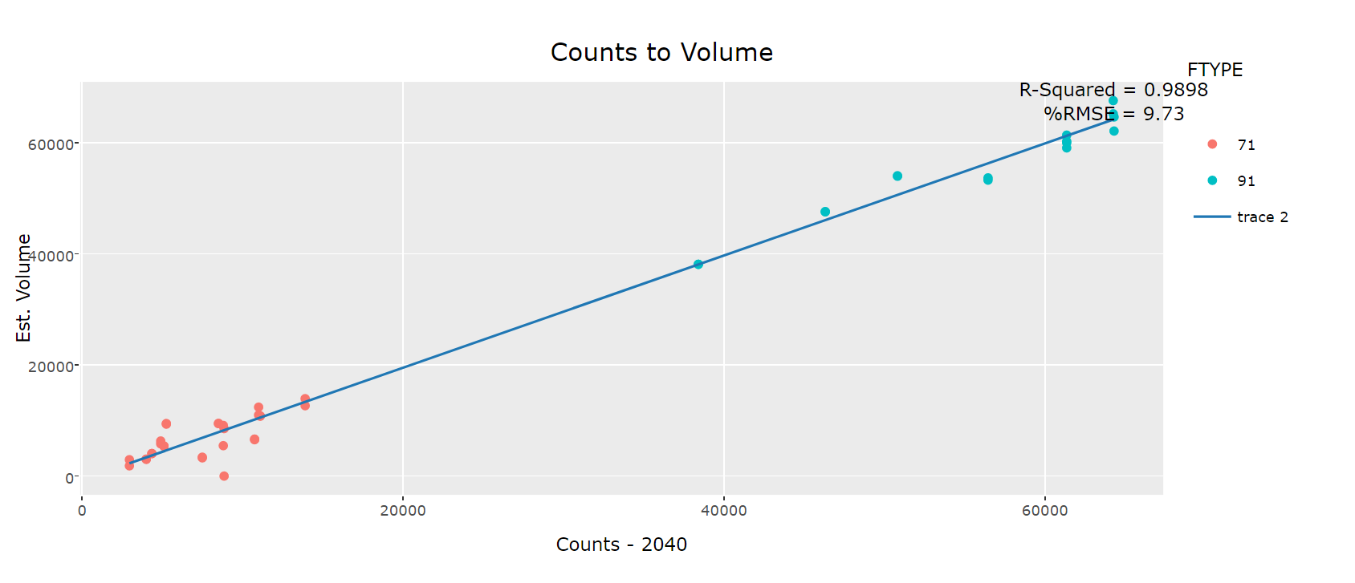
2040 ODME “Goodness of Fit”
ODME - Validation
Very tight convergence
91 – Mainline 71 - Ramps
Further investigation

Slide 10
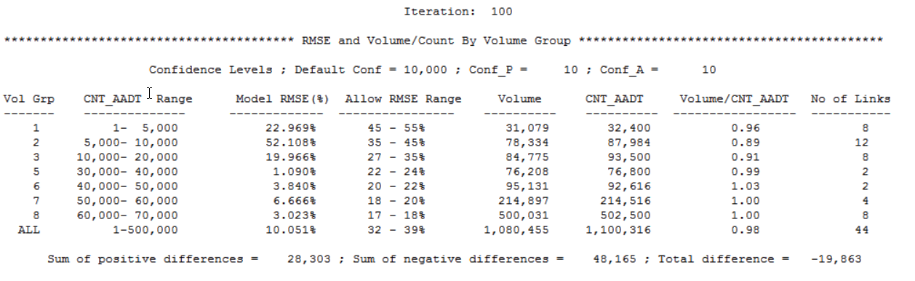
2040 ODME Stats
ODME - Validation

Slide 11
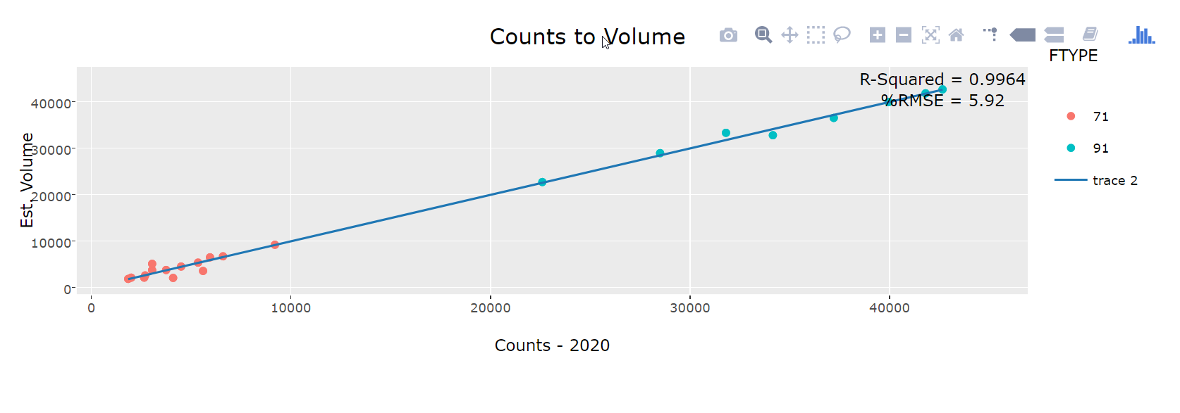
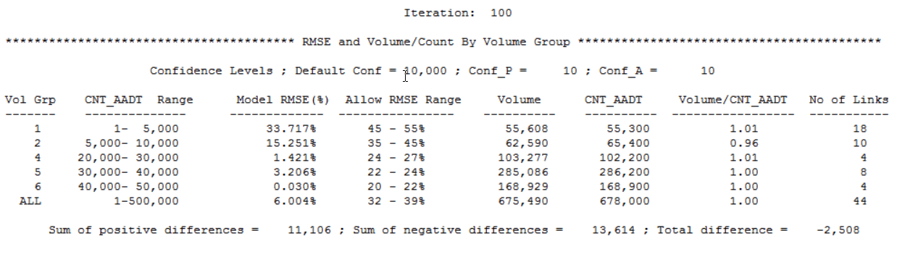
2020 ODME “Goodness of Fit”
ODME - Validation
See interactive graphic
91 – Mainline 71 - Ramps

Slide 12
ODME - Validation
Comparison of ODME Estimated volumes to TEAR and TREND AADTS

Slide 13
ELTod v2.2
Section - 2

Slide 14
Hourly Distributions (AADT) based on March, 2017 counts
ELTOD - Application

Slide 15
ELTod v2.2 vs v2.3
Section - 3

Slide 16
Overview
Input Question:
No impact on the current runs but useful for later discussion. Clarification on the Profile numbers (Inconsistency between Toll Plan/ Existing and Profile ramp location between Anderson Rd and Waters Ave).
Output Results:
Comparison of ICPP and ELToD 2.2 Old Policy results
Comparison of ELToD 2.2 Old Policy results vs. ELToD 2.3 New Policy results
Old and new policies use same, old hourly parameters
Old and new policies use different hourly parameters (old and new respectively)

Slide 17
Overview
Input Question:
No impact on the current runs but useful for later discussion. Clarification on the Profile numbers (Inconsistency between Toll Plan/ Existing and Profile ramp location between Anderson Rd and Waters Ave).
Output Results:
Comparison of ICPP and ELToD 2.2 Old Policy results
Comparison of ELToD 2.2 Old Policy results vs. ELToD 2.3 New Policy results
Old and new policies use same, old hourly parameters
Old and new policies use different hourly parameters (old and new respectively)

Slide 18
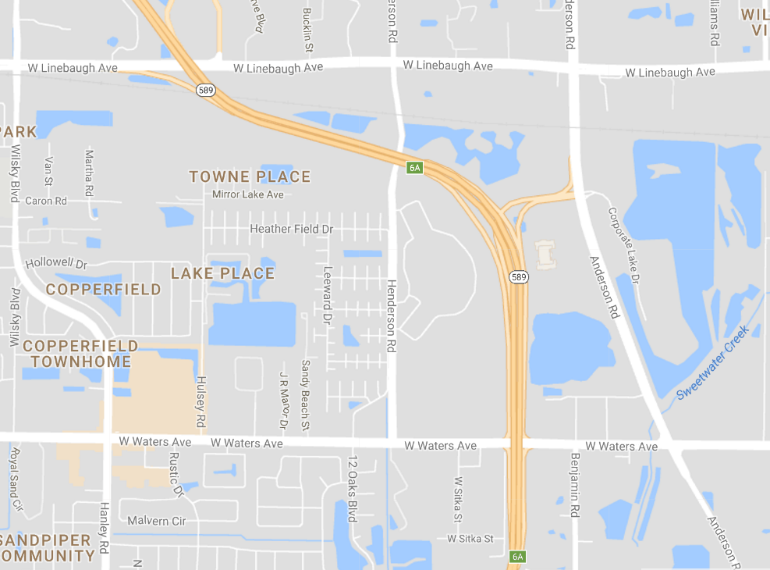
Input Question:
No impact on the current runs
112,900 – 22,000 + 9,800 = 100,700 ?

Slide 19
Model Results
Input Question:
No impact on the current runs but useful for later discussion. Clarification on the Profile numbers (Inconsistency between Toll Plan/ Existing and Profile ramp location between Anderson Rd and Waters Ave).
Output Results:
Comparison of ICPP and ELToD 2.2 Old Policy results
Comparison of ELToD 2.2 Old Policy results vs. ELToD 2.3 New Policy results
Old and new policies use same, old hourly parameters
Old and new policies use different hourly parameters (old and new respectively)

Slide 20
ICPP vs. Old Policy (LOS-A Pays)
ELTOD - Application

Slide 21
Model Results
Input Question:
No impact on the current runs but useful for later discussion. Clarification on the Profile numbers (Inconsistency between Toll Plan/ Existing and Profile ramp location between Anderson Rd and Waters Ave).
Output Results:
Comparison of ICPP and ELToD 2.2 Old Policy results
Comparison of ELToD 2.2 Old Policy results vs. ELToD 2.3 New Policy results
Old and new policies use same, old hourly parameters
Old and new policies use different hourly parameters (old and new respectively)

Slide 22
Hourly Parameters
ELTOD - Application

Slide 23
Model Results
Input Question:
No impact on the current runs but useful for later discussion. Clarification on the Profile numbers (Inconsistency between Toll Plan/ Existing and Profile ramp location between Anderson Rd and Waters Ave).
Output Results:
Comparison of ICPP and ELToD 2.2 Old Policy results
Comparison of ELToD 2.2 Old Policy results vs. ELToD 2.3 New Policy results
Old and new policies use same, old hourly parameters
Old and new policies use different hourly parameters (old and new respectively)

Slide 24
Old (LOS-A Pays) vs. New Policy (LOS-A is Free)
ELTOD - Application

Slide 25
Old vs. New Policy with same, old hourly parameters
2020
2040
Old Policy
New Policy
2020: About 35% increase in EL volume over old policy
2040: only 13% increase in EL volume over old policy
LOS-A: Both in 2020 and 2040 all growth in EL vol happens in LOS A.
No impact to LOS B and higher
EL Shares: New policy shows a slight increase in EL Share (to Corridor) to 6.8% in 2020 and 7.6% in 2040
The share of EL trips decrease in LOS B and C as the total EL vol increase

Slide 26
Model Results
Input Question:
No impact on the current runs but useful for later discussion. Clarification on the Profile numbers (Inconsistency between Toll Plan/ Existing and Profile ramp location between Anderson Rd and Waters Ave).
Output Results:
Comparison of ICPP and ELToD 2.2 Old Policy results
Comparison of ELToD 2.2 Old Policy results vs. ELToD 2.3 New Policy results
Old and new policies use same, old hourly parameters
Old and new policies use different hourly parameters (old and new respectively)

Slide 27
Old (LOS-A Pays) vs. New Policy (LOS-A is Free)
ELTOD - Application

Slide 28
Old vs. New Policy with different hourly parameters
2020
2040
Old Policy
New Policy
2020: About 98% increase in EL volume over old policy
2040: only 57% increase in EL volume over old policy
LOS-A:
In 2020 most of the EL trip increase (83%) occurs in LOSA and some (17%) in LOSB.
In 2040 about 73% EL trip increase is in LOSA and another 8% and 19% in LOS B and C respectively .
EL Shares: New policy shows a significant increase in EL Share (to Corridor) to 10 % in 2020 and 2040.
The share of EL trips decrease in LOS B and C as the total EL vol increase

Slide 29
Model Results
Input Question:
No impact on the current runs but useful for later discussion. Clarification on the Profile numbers (Inconsistency between Toll Plan/ Existing and Profile ramp location between Anderson Rd and Waters Ave).
Output Results:
Comparison of ICPP and ELToD 2.2 Old Policy results
Comparison of ELToD 2.2 Old Policy results vs. ELToD 2.3 New Policy results
Old and new policies use same, old hourly parameters
Old and new policies use different hourly parameters (old and new respectively)
New policy results comparison with old and new hourly parameters

Slide 30
New Policy (LOS-A is Free) Old vs. New Hourly Parameters
ELTOD - Application

Slide 31
Hourly Distributions (AAWDT vs. AADT)
Section - 4

Slide 32
Hourly Distributions (AADT vs AAWDT)

Slide 33
2017 Observed vs 2020 Model Est.
Obs vs Est
2020 Estimated Corridor level volumes are lower than 2017 observed data. Although 2017 observed is only one week AAWDT, it’s still much lower than the TEAR forecast for 2020.

Slide 34
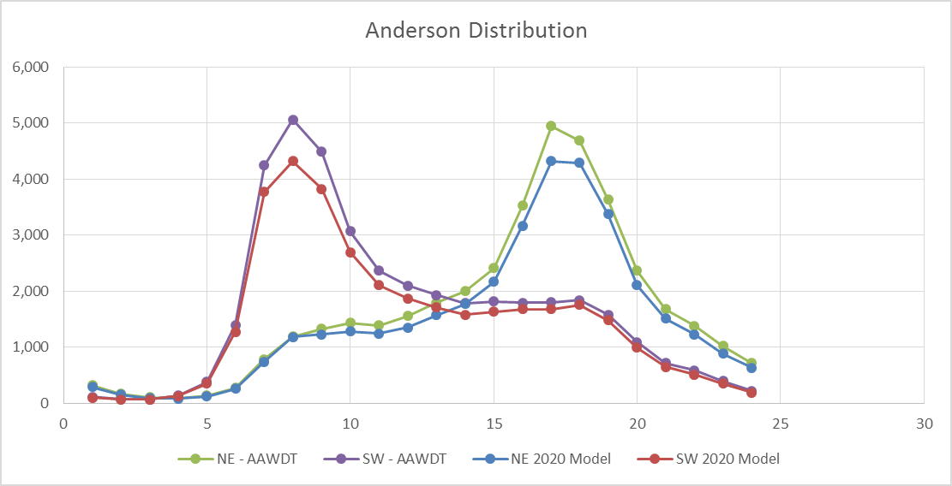
2017 Observed vs 2020 Model Est.
Obs vs Est
2020 Estimated Corridor level volumes are lower than 2017 observed data. Although 2017 observed is only one week AAWDT, it’s still much lower than the TEAR forecast for 2020.

Slide 35
Hourly Parameters (revised)
Section - 5

Slide 36
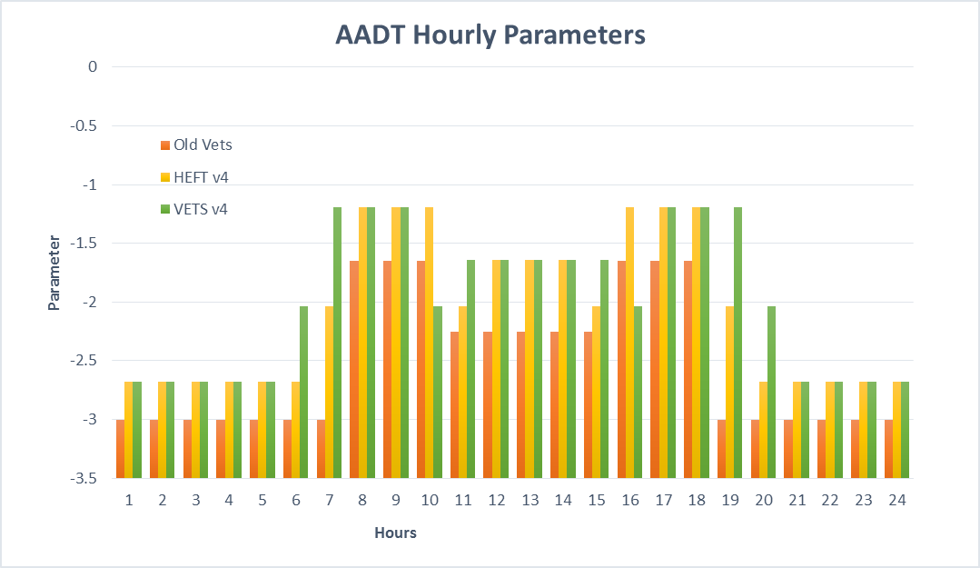
Revised Hourly Parameters

Slide 37
AAWDT: Old (LOS-A Pays) vs. New Policy (LOS-A is Free)
ELTOD - Application
NOT Comparable:
Hourly distributions + hourly parameters should be consistent (one changes the other must change) across base and new models.
The only time these can be different is under a single policy

Slide 38
Old vs. New Policy with different hourly parameters
2020
2040
Old Policy
New Policy
2020: About 90% increase in EL volume over old policy
2040: only 44% increase in EL volume over old policy
LOS-A:
In 2020 most of the EL trip increase (80%) occurs in LOSA and some (20%) in LOSB.
In 2040 about 50% EL trip increase is in LOSA and another 5% and 45% in LOS B and C respectively .
NOT Comparable:
Hourly distributions + hourly parameters should be consistent (one changes the other must change) across base and new models.
The only time these can be different is under a single policy
EL Shares: New policy shows a significant increase in EL Share (to Corridor) to 10 % and 11.6% in 2020 and 2040 respectively.

Slide 39
Revised Hourly Parameters Old (LOS-A Pays) vs. New Policy (LOS-A is Free)
ELTOD - Application

Slide 40
Old vs. New Policy with different hourly parameters
2020
2040
Old Policy
New Policy
2020: About 99% increase in EL volume over old policy
2040: only 51% increase in EL volume over old policy
NOT Comparable:
Hourly distributions + hourly parameters should be consistent (one changes the other must change) across base and new models.
The only time these can be different is under a single policy
EL Shares: New policy shows a significant increase in EL Share (to Corridor) to 10.5 % and 12 % in 2020 and 2040 respectively.

Slide 41
August 01, 2017
Model Recap of August 01, results:
Enhanced ODME (new OD trip table)
Hourly distribution based on observed data (Mar 2017)
AADT
AAWDT
Revised hourly parameters
Model enhancements:
Shoulder hours
LOS B and C
High Toll rates

Slide 42
ICPP vs. Old (LOS-A Pays) with AAWDT Hourly Distributions and revised Parameters
ELTOD - Application

Slide 43
AAWDT Hourly Distribution + Revised Parameters Old (LOS-A Pays) vs. New Policy (LOS-A is Free)
ELTOD - Application

Slide 44
Old vs. New Policy with AAWDT and revised parameters
2020
2040
Old Policy
New Policy
2020: About 23% increase in EL volume over old policy
2040: only 10% increase in EL volume over old policy
LOS-A:
In 2020 most of the EL trip increase (80%) occurs in LOSA and some (20%) in LOSB.
In 2040 about 50% EL trip increase is in LOSA and another 5% and 45% in LOS B and C respectively .
EL Shares: New policy shows a slight increase in EL Share (to Corridor) to 10.5 % and 12.6% in 2020 and 2040 respectively.

Slide 45
Issue #1: Resolve the shoulder hours dips

Slide 46
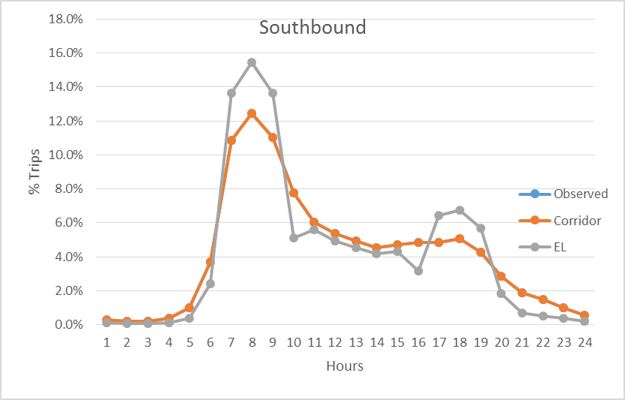
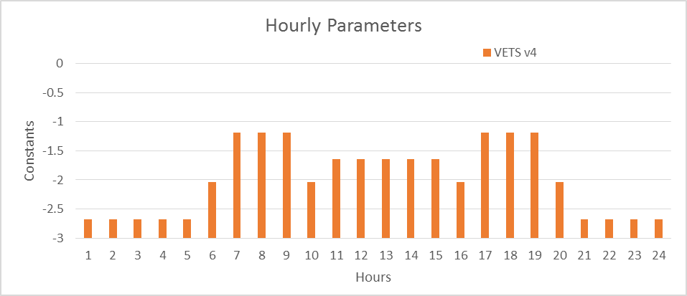
Distributions and Hourly Parameters
Issue: The EL shares by hour show dips at two shoulder hours: 10 and 16

Slide 47
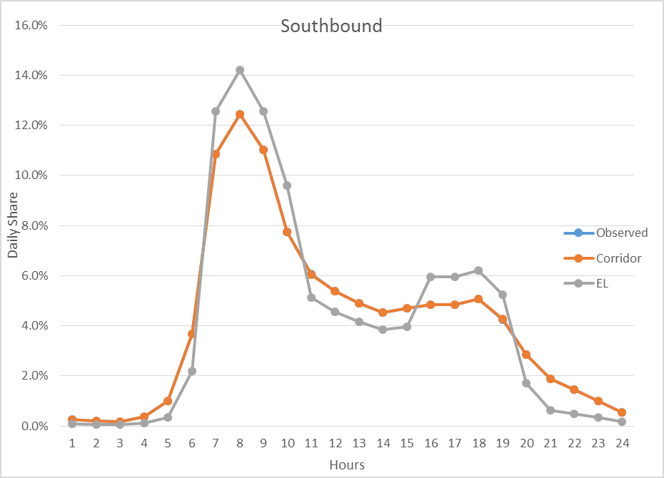
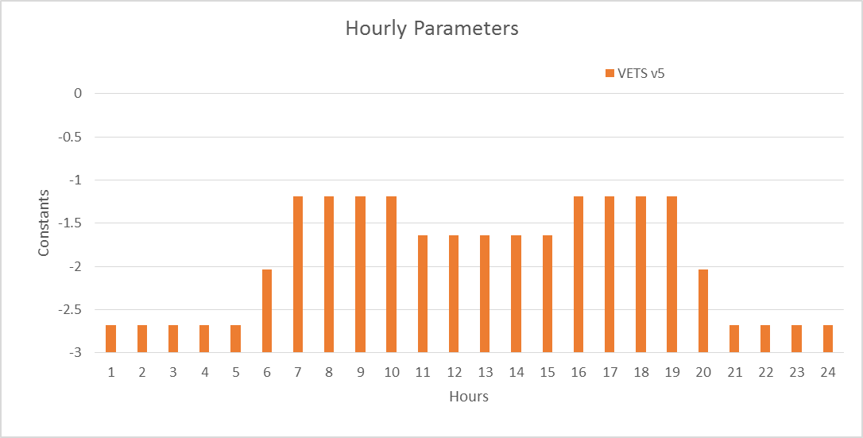
Distributions and Hourly Parameters
Revised Hourly Parameters

Slide 48
Issue #2: No LOS B and High LOS C
The EL shares for the peak hours are too high (over 20%) which produces EL volumes of ~1500 resulting in VC over 0.8 and that in turn is creating high LOS C volumes as well as high toll rates.

Slide 49
Level of Service and Hourly Parameters
2020
2040
Old Policy
New Policy
LOS C volumes are much higher than LOS B.

Slide 50
Issue #3: Toll rates are too high
The EL shares for the peak hours are too high (over 20%) which produces EL volumes of ~1500 resulting in VC over 0.8 and that in turn is creating high LOS C volumes as well as high toll rates.

Slide 51
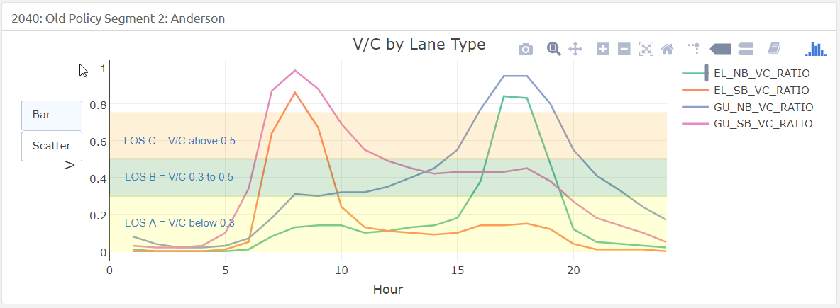
High V/C Results = High Toll Rates
73 ₵
19 ₵
19 ₵

Slide 52
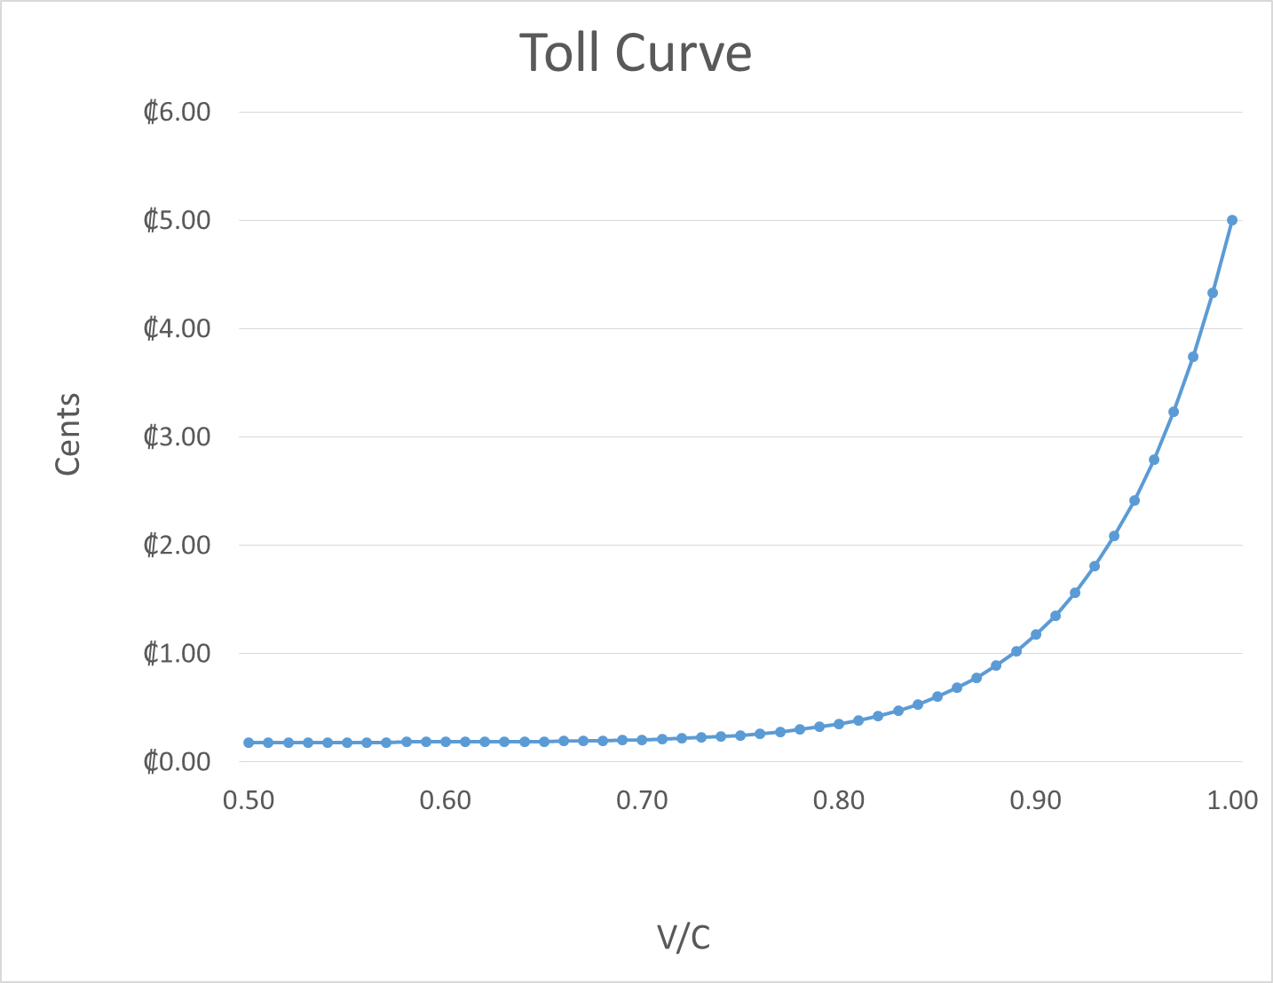
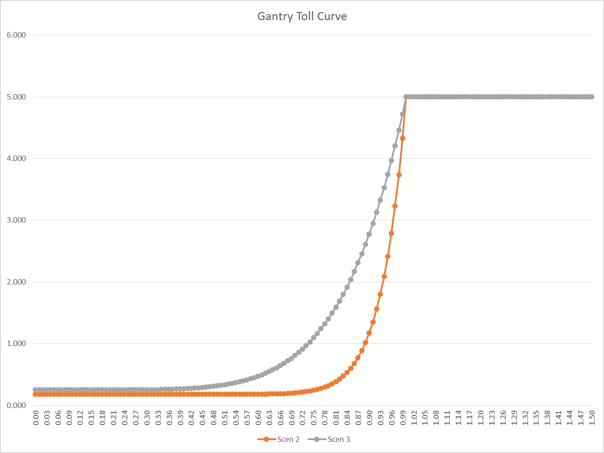
Toll Curve
73 ₵
19 ₵
34 ₵
The toll rate increases from 19 cents to 73 cents between
V/C 0.65 and 0.85. Even more steeper between 0.8 and 0.87 from 34 cents to 77 cents

Slide 53
Solution to Issues #2 and #3

Slide 54
Two approaches
Use observed data (15 mins or even more disaggregate data) to split hourly assigned volumes into 3 categories LOS A, LOS B and LOS C.
Adjust Hourly distributions slightly to get overall corridor volumes below ~9666 which is v/c 0.9.

Slide 55
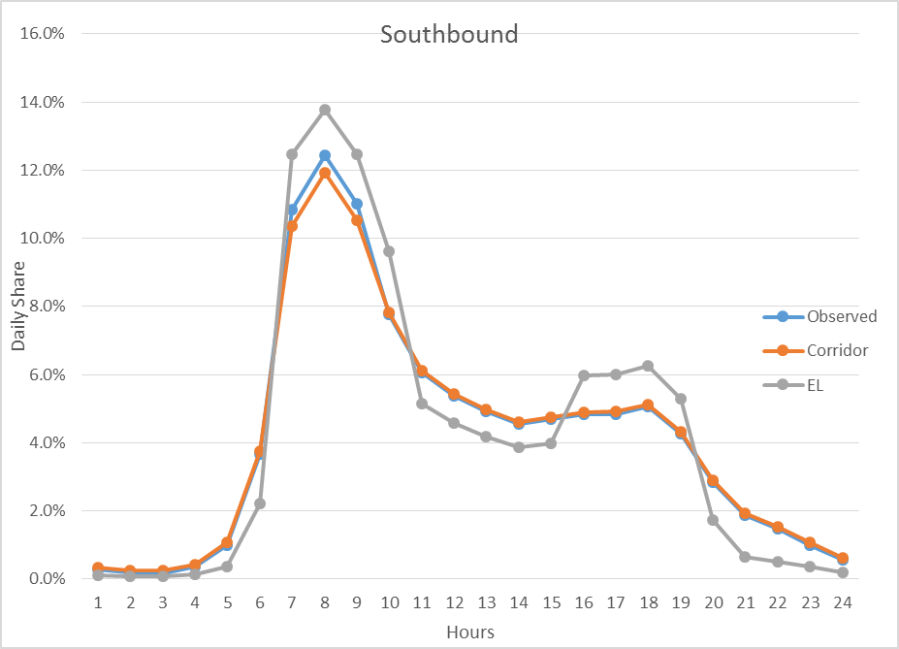
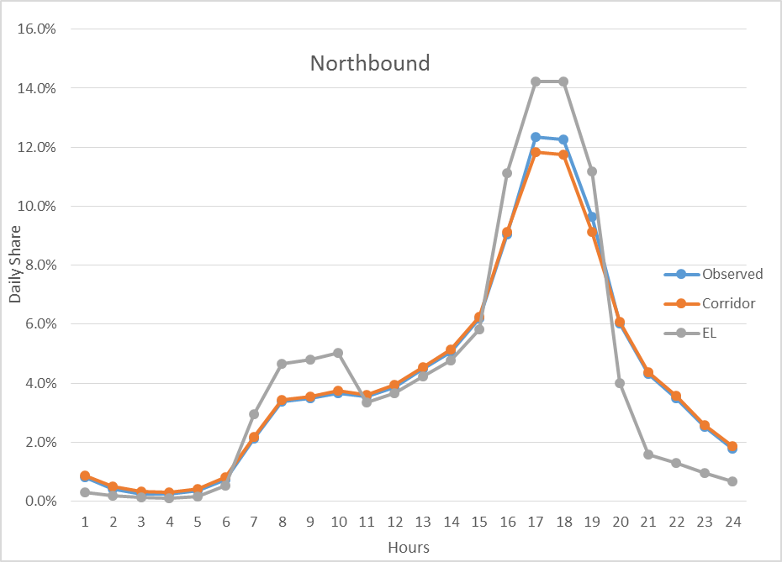
Adjusted hourly volumes
Peak hour shares were dropped by 0.5% from the observed

Slide 56
Level of Service and Hourly Parameters
2020
2040
Old Policy
New Policy
LOS C volumes are still higher than LOS B but reasonable

Slide 57
Estimated toll rates by hours
The toll rates were dropped to 36 cents from 73 cents lowering the v/c to 0.81 from 0.86.

Slide 58
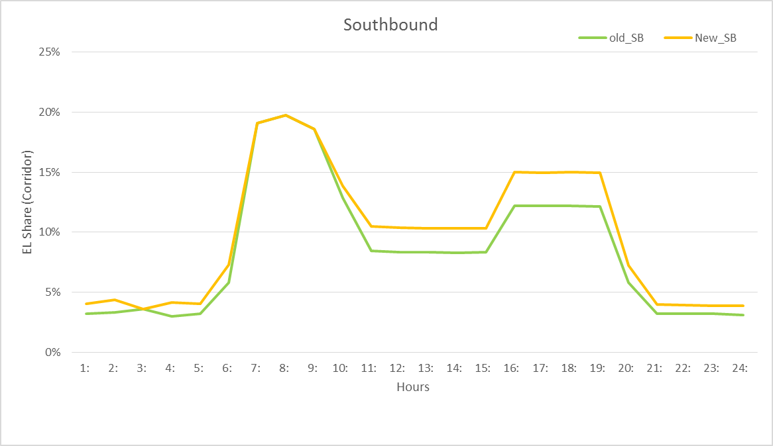
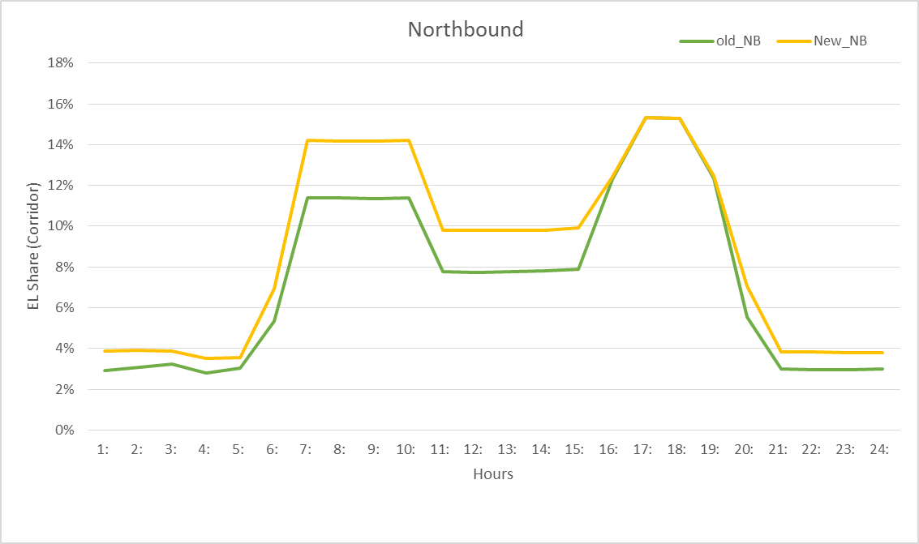
Old vs New Policy %EL Shares
Southbound EL Shares
Northbound EL Shares

